Slide 1
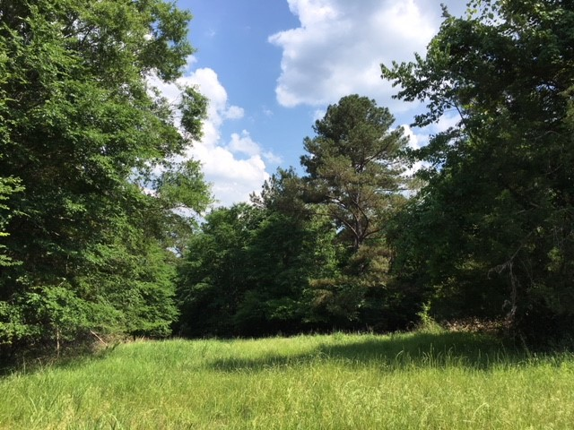
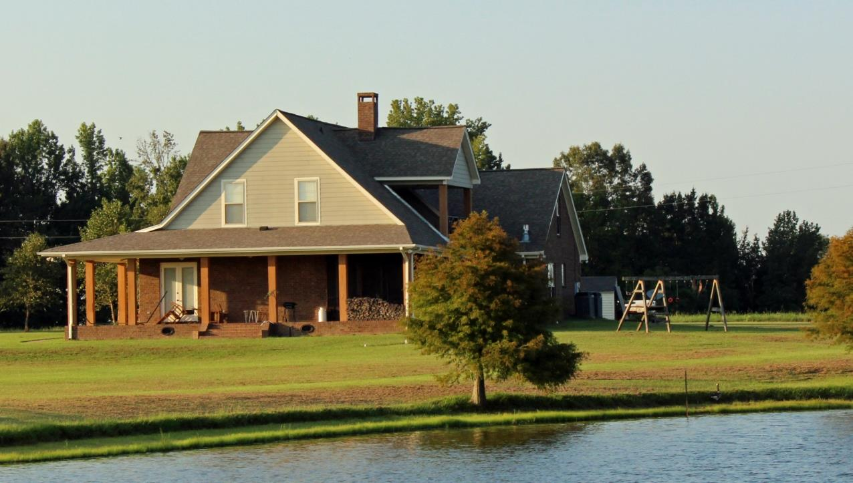
Great Homesite on 4+/- Acres Madison County, MS
Information is believed to be accurate but not guaranteed
$85,000
Looking to get out of a subdivision and build your dream home? Check out this rolling 4 +/- acre tract in Madison County off Hwy 463! The property features nearly 500 feet of road frontage on Hwy 463 and has several good homesites to build on with a mix of pine and hardwoods. Your new home would be located less than a mile from the town of Livingston and great restaurants! This property is located in the Germantown school zone of Madison County. It is in 16 section land. Call Barry Holt for your private showing!
Directions: From I-55 take the Madison exit and travel west. Travel 8 miles and the property will be on the right.

Slide 2
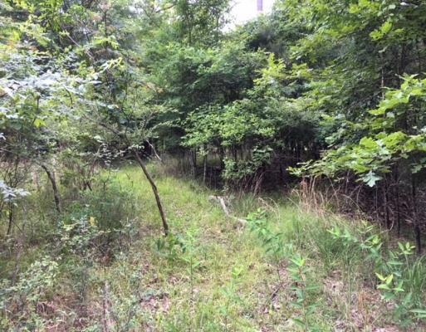
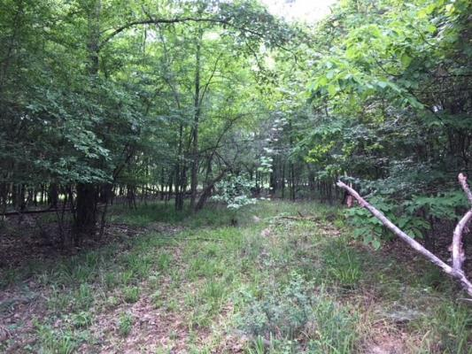
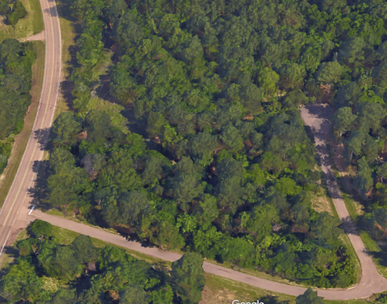
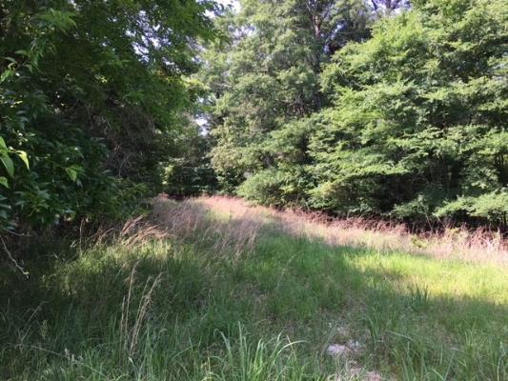
Madison County Homesite 4+/- Acres
Information is believed to be accurate but not guaranteed

Slide 3
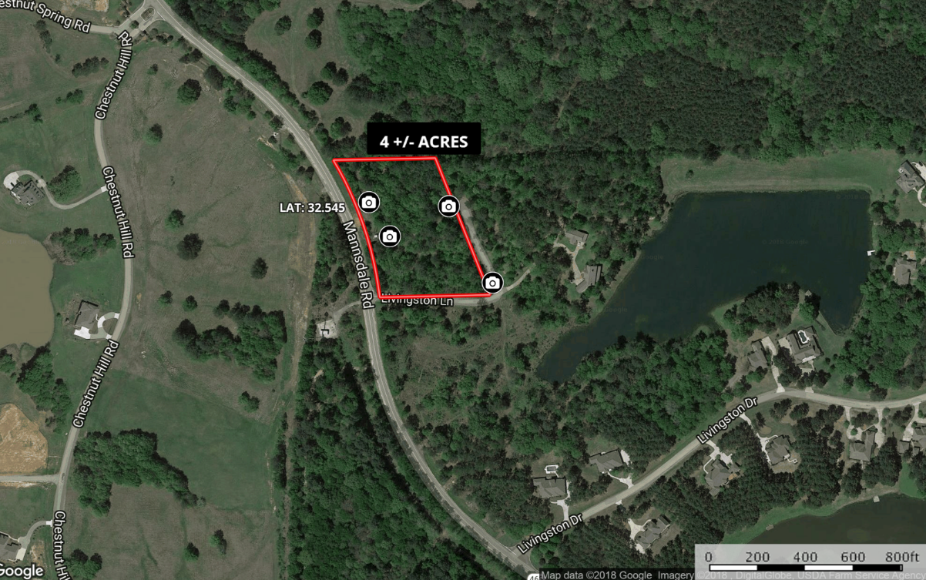
Information is believed to be accurate but not guaranteed
Interactive Map

Slide 4
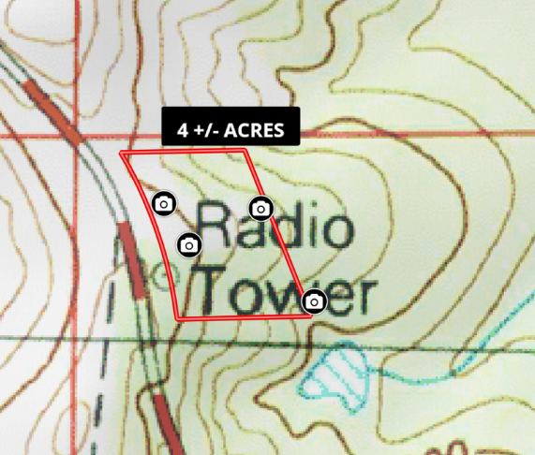
Information is believed to be accurate but not guaranteed
TOPO MAP

Slide 5
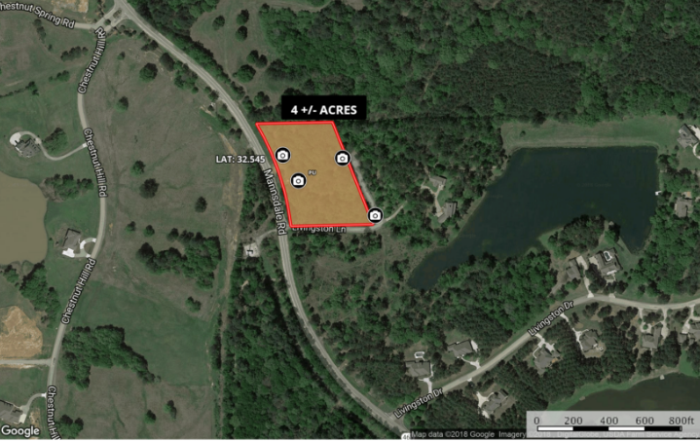
Information is believed to be accurate but not guaranteed
Soil Map

Slide 6
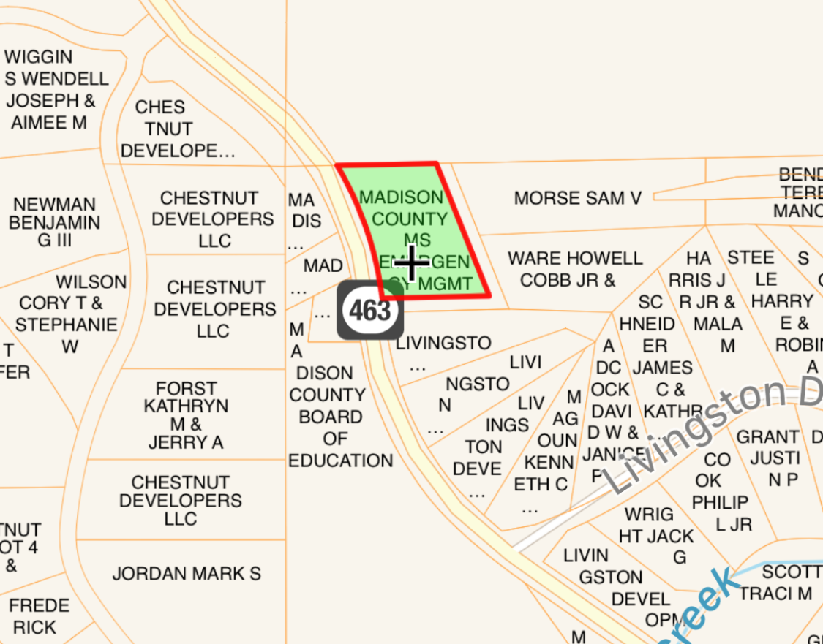
Information is believed to be accurate but not guaranteed
OWNERSHIP MAP

Slide 7
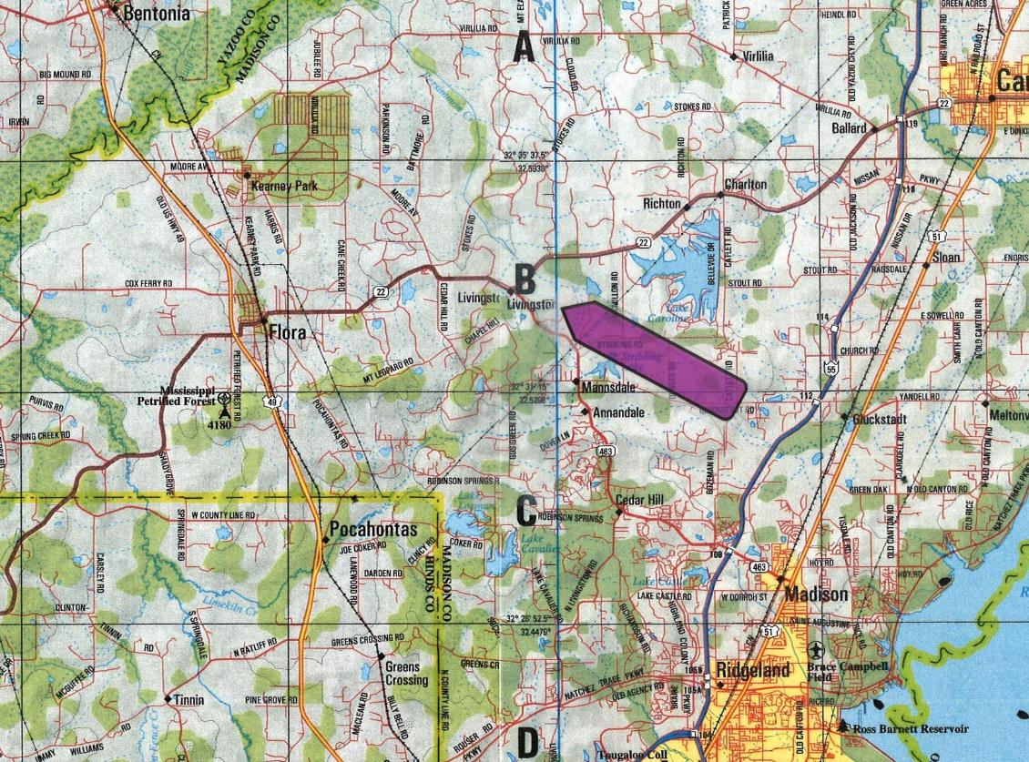
Information is believed to be accurate but not guaranteed
DIRECTIONAL MAP
Directions: From I-55 take the Madison Exit and travel west. Go 8 Miles and the property will be on the right.

